Slide 1

Module 3
Dimension Reduction
Notes:
Guidelines
Use section headers to chunk content in your presentation.
Use the same style of section header throughout your presentation.
Keep your title to no more than 2 lines.

Slide 2
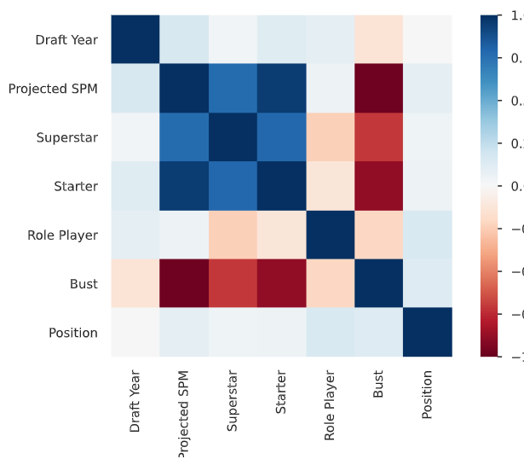
Reducing Dimensionality for Numeric Variables
Notes:
Guidelines
Use a title slide at the beginning of your presentation. There are 9 variations of title slides to choose from.
If you will have a series of slideshows, we recommend using the same style of title slide for each presentation.
Keep your title to no more than 2 lines.
Do not change the font style or font size of the title or subtitle.

Slide 3
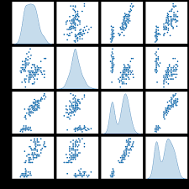
Reducing Redundancy in Numeric Vars
Continuous variables cost 1 model degree of freedom each.
We only consider reducing redundant continuous variables.

Slide 4
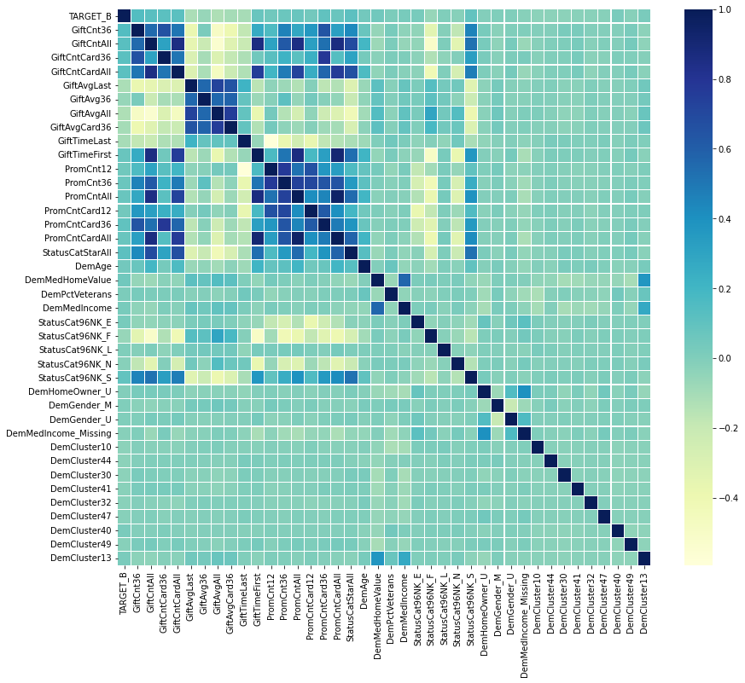
Reducing Redundancy in Numeric Vars

Slide 5
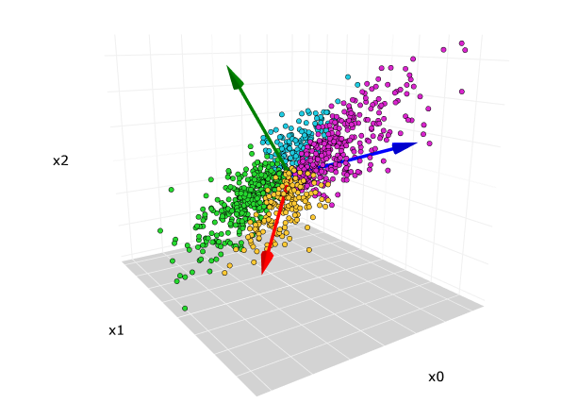
Principal Component Analysis
Used to remove redundancy (high collinearity) of predictors
Based on covariance and variance

Slide 6
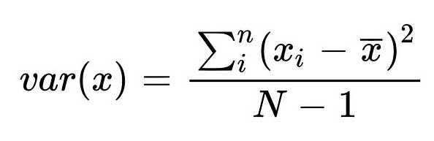
Principal Component Analysis
Variance is an estimate of variability
More variability implies more information

Slide 7
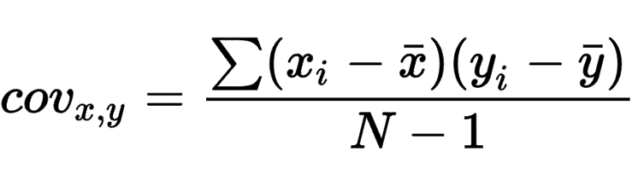
Principal Component Analysis
Covariance is an estimate of joint variability of two variables
Higher covariance implies a higher relationship between vars

Slide 8
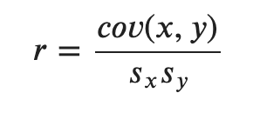
Principal Component Analysis
The correlation coefficient is related to the covariance

Slide 9
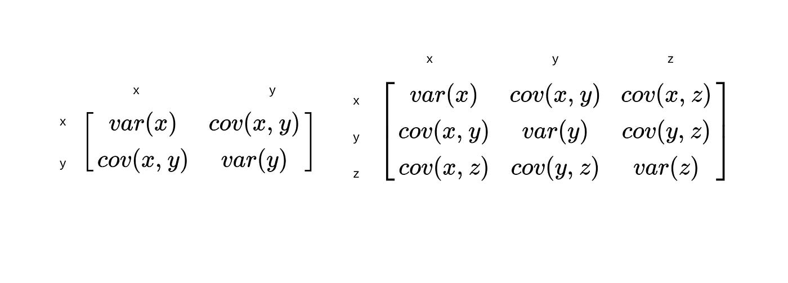
Principal Component Analysis
The covariance matrix allows us to see both variances and covariances

Slide 10
Principal Component Analysis
Create new variables (PCs) that keep high variance (information)
PCs are linear combinations of variables (keep info about all)
PCs must have covariances equal to zero

Slide 11
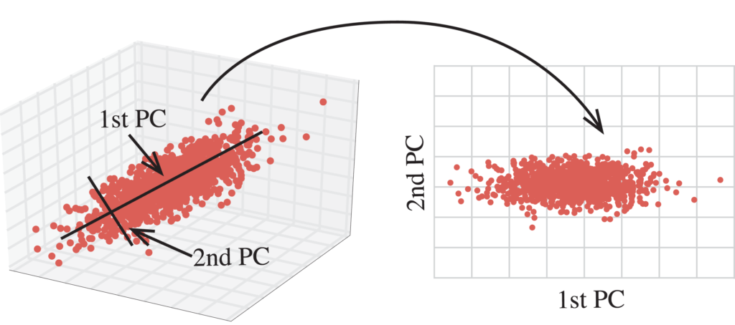
Principal Component Analysis
Create new variables (PCs) that keep high variance (information)

Slide 12
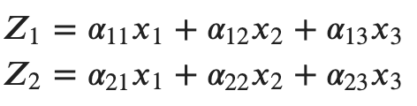
Principal Component Analysis
PCs are linear combinations of variables (keep info about all)

Slide 13
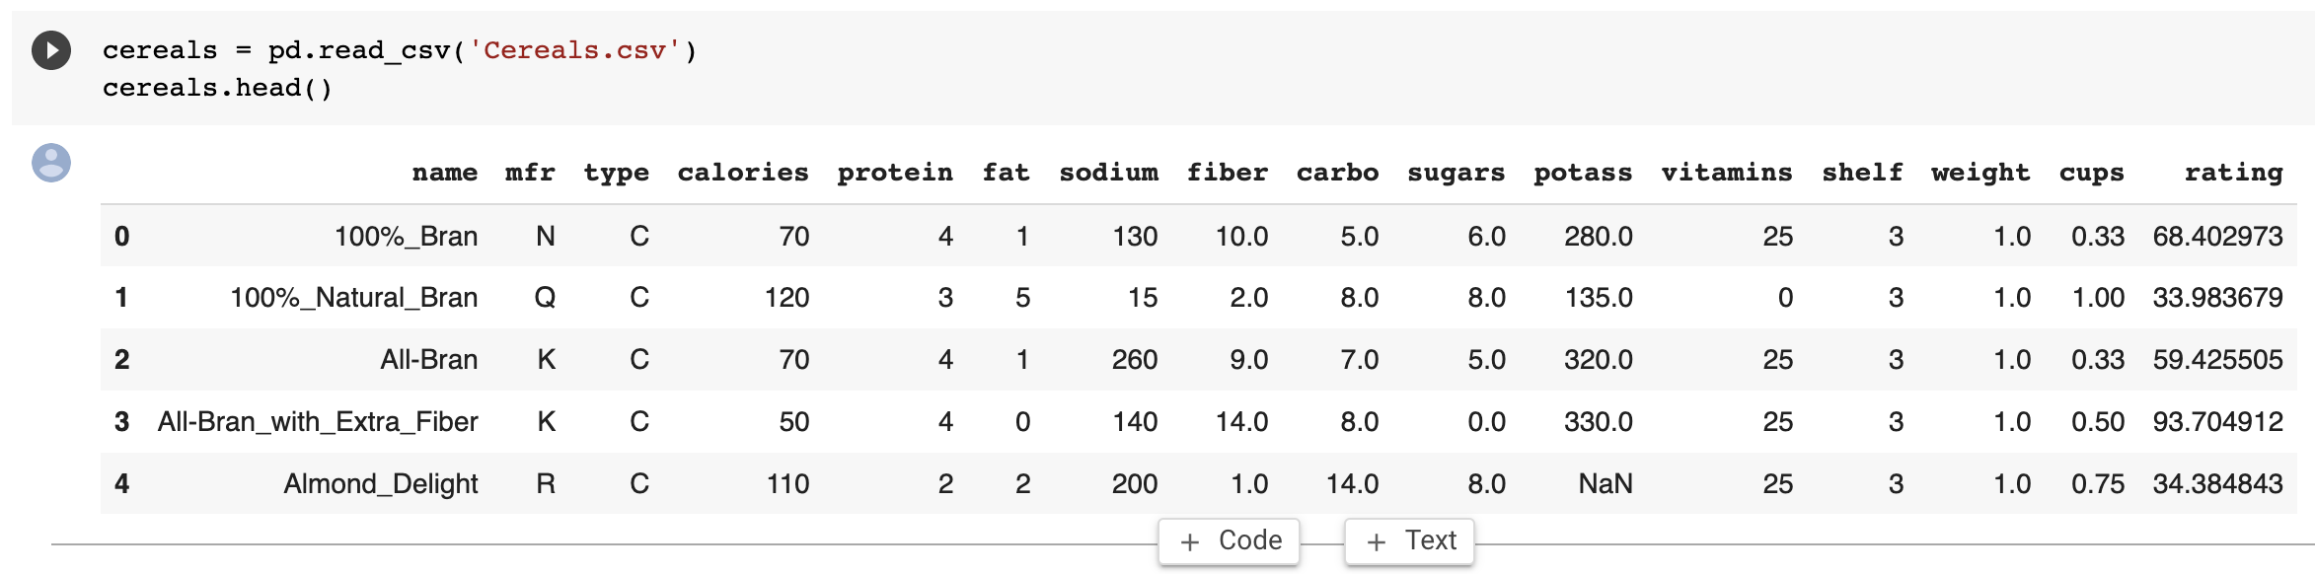
Principal Component Analysis
Cereals data example

Slide 14
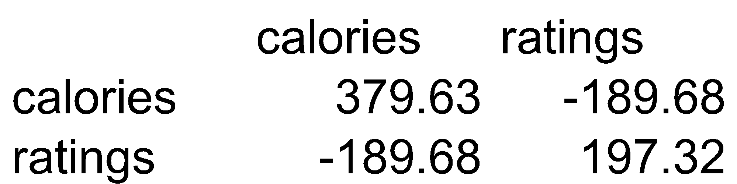
Principal Component Analysis
Cereals data example

Slide 15
Principal Component Analysis
Total variance (“information”) is sum of individual variances
Calories accounts for 379.63/577 = 66% of information
34% of the variation information is contributed by Ratings

Slide 16
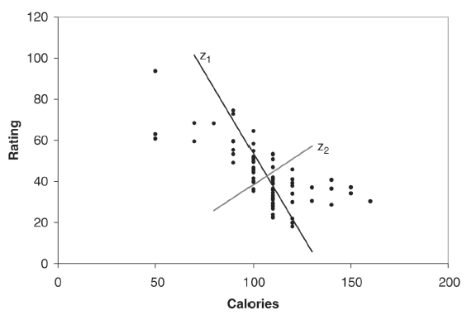
Principal Component Analysis
Z₁ and Z₂ are two linear combinations.
Z₁ has the highest variation (spread of values)
Z₂ has the lowest variation
PC1 PC2
[1,] 44.921528 2.1971833
[2,] -15.725265 -0.3824165
[3,] 40.149935 -5.4072123
[4,] 75.310772 12.9991256
[5,] -7.041508 -5.3576857

Slide 17
Python
Notes:
Guidelines
Use a title slide at the beginning of your presentation. There are 9 variations of title slides to choose from.
If you will have a series of slideshows, we recommend using the same style of title slide for each presentation.
Keep your title to no more than 2 lines.
Do not change the font style or font size of the title or subtitle.

Slide 18
Selecting the Number of PCs
You can predetermine the percent of variation to keep
Say you wish to keep the number of PCs that account for >90%
PC1 PC2 PC3 PC4 PC5 PC6
Standard deviation 83.7641 70.9143 22.6437 19.1815 8.4232 2.0917
Proportion of variance 0.5395 0.3867 0.0394 0.0283 0.0055 0.0003
Cumulative proportion 0.5395 0.9262 0.9656 0.9939 0.9993 0.9997
PC7 PC8 PC9 PC10 PC11 PC12 PC13
Standard deviation 1.6994 0.7796 0.6578 0.3704 0.1864 0.063 0.0
Proportion of variance 0.0002 0.0000 0.0000 0.0000 0.0000 0.000 0.0
Cumulative proportion 0.9999 1.0000 1.0000 1.0000 1.0000 1.000 1.0
The first two components account for 93% of the total variance, so using 2-3 components in further modeling would probably be sufficient

Slide 19
Python
Notes:
Guidelines
Use a title slide at the beginning of your presentation. There are 9 variations of title slides to choose from.
If you will have a series of slideshows, we recommend using the same style of title slide for each presentation.
Keep your title to no more than 2 lines.
Do not change the font style or font size of the title or subtitle.

Slide 20
Selecting the Number of PCs
We must normalize the data prior to PCA
Normalizing avoids high-variance variables to dominate
PC1 PC2 PC3 PC4 PC5 PC6
Standard deviation 1.9192 1.7864 1.3912 1.0166 1.0015 0.8555
Proportion of variance 0.2795 0.2422 0.1469 0.0784 0.0761 0.0555
Cumulative proportion 0.2795 0.5217 0.6685 0.7470 0.8231 0.8786
PC7 PC8 PC9 PC10 PC11 PC12 PC13
Standard deviation 0.8251 0.6496 0.5658 0.3051 0.2537 0.1399 0.0
Proportion of variance 0.0517 0.0320 0.0243 0.0071 0.0049 0.0015 0.0
Cumulative proportion 0.9303 0.9623 0.9866 0.9936 0.9985 1.0000 1.0

Slide 21
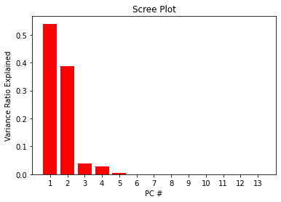
Selecting the Number of PCs
You can use a scree plot to determine the contribution of PCs

Slide 22
Python
Notes:
Guidelines
Use a title slide at the beginning of your presentation. There are 9 variations of title slides to choose from.
If you will have a series of slideshows, we recommend using the same style of title slide for each presentation.
Keep your title to no more than 2 lines.
Do not change the font style or font size of the title or subtitle.

